Slide 1
Strategies and Tasks to Build Procedural Fluency from Conceptual Understanding
Please take a handout.
Sit near someone for partner discussion
Diane J. Briars
President
National Council of Teachers of Mathematics dbriars@nctm.org
Teaching & Learning 2016
March 11, 2016

Slide 2
FYI
Electronic copies of slides are available
by request
dbriars@nctm.org

Slide 3
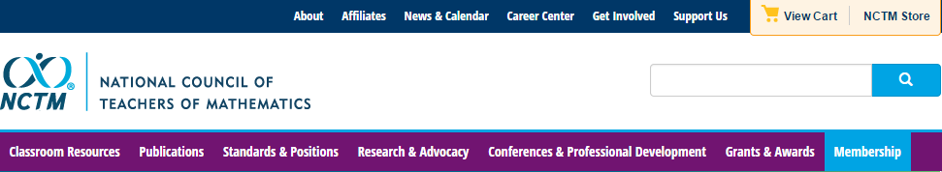
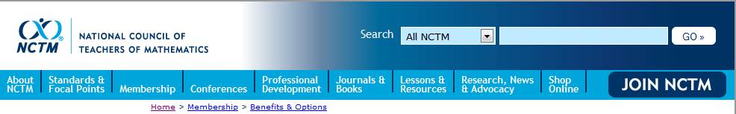
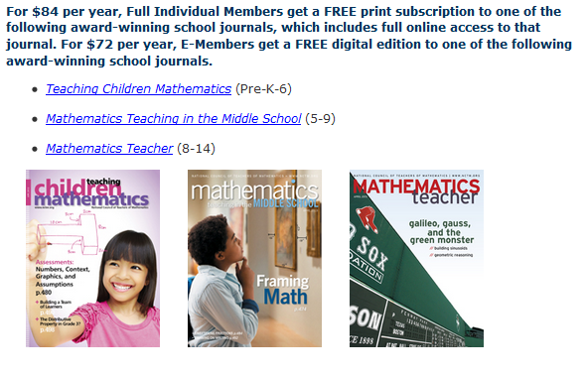
National Council of Teachers of Mathematics www.nctm.org

Slide 4



National Council of Teachers of Mathematics www.nctm.org
National Council of Teachers of Mathematics
www.nctm.org
For $144 per year, your school will get a FREE print-only subscription to one of the following award-winning journals:
Five FREE E-Memberships for teachers in your school
All the benefits of an e-membership including full access to
the digital edition of Teaching Children Mathematics or
Mathematics Teaching in the Middle School (a $72 value!) FREE!
To involve more teachers, additional e-memberships can be added
for just $10 each.

Slide 5
National Council of Teachers of Mathematics www.nctm.org
National Council of Teachers of Mathematics
www.nctm.org
New Member Discount
$20 off for full membership
$10 off e-membership
$5 off student membership
Use Code: BDB0616

Slide 6

NCTM Conferences www.nctm.org
  2016 Annual Meeting and Exposition
  April 13–16, 2016
  San Francisco

Slide 7
NCTM Interactive Institutes www.nctm.org
Engaging Students in Learning: Mathematical Practices, Grades K-8
July 11 – July 13, 2016, Atlanta, GA
Engaging Students in Learning: Mathematical Practices and Process Standards, High School
July 14 – July 16, 2016, Atlanta, GA
Algebra Readiness Institute, Grades 6-8
July 18-20, 2016, Denver, CO
Number and Operations Institute, Grades Pk-5
July 21-23, 2016, Denver CO

Slide 8
NCTM Regional Conferences www.nctm.org
Phoenix
October 26–28, 2016
Philadelphia, PA
October 31–November 2, 2016

Slide 9

NCTM Innov8
November 16-18, 2016, St. Louis
“Engaging the Struggling Learner”
Community. Collaboration. Solutions.
Bring your team and engage in a hands-on, interactive, and new
learning experience for mathematics education.
With a focus on “Engaging the
Struggling Learner,” become part
of a team environment and navigate
your experience through three
different pathways:
Response to Intervention (RtI)
Supporting productive struggle
Motivating the struggling learner

Slide 10
Key Questions
What is procedural fluency?
What instructional practices promote students’ development of procedural fluency?
How can I implement these practices in my classroom?

Slide 11
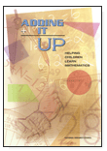
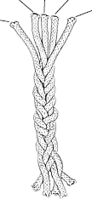
Strands of Mathematical Proficiency
Conceptual Understanding
Strategic Competence
Productive Disposition
Adaptive Reasoning
Procedural Fluency
NRC (2001). Adding It Up. Washington, D.C.: National Academies Press.
Notes:
Turn and talk, what does the graphic communicate about the nature of the 5 strands

Slide 12
Key Features of CCSS-M
Focus: Focus strongly where the standards focus.
Coherence: Think across grades, and link to major topics
Rigor: In major topics, pursue conceptual understanding, procedural skill and fluency, and application
Standards for Mathematical Practice

Slide 13
Key Features of CCSS-M
Focus: Focus strongly where the standards focus.
Coherence: Think across grades, and link to major topics
Rigor: In major topics, pursue conceptual understanding, procedural skill and fluency, and application
Standards for Mathematical Practice

Slide 14
Discuss with a Shoulder Partner
What does it mean to be fluent with procedures?

Slide 15
What is Procedural Fluency?
Which students demonstrate procedural fluency? Evidence for your answer?
Alan
Ana
Marissa

Slide 16
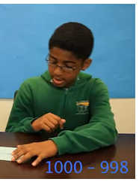
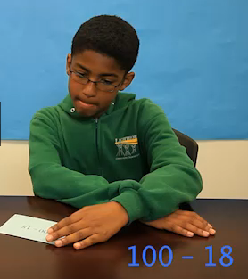
Alan
1000 - 98
100 - 18
https://mathreasoninginventory.com/Home/VideoLibrary
Source: The Marilyn Burns Math Reasoning Inventory

Slide 17
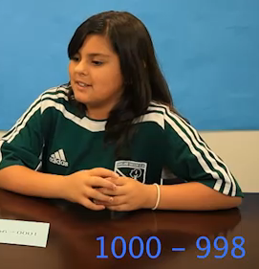
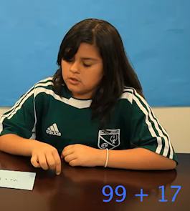
Ana
1000 - 98
99 + 17
https://mathreasoninginventory.com/Home/VideoLibrary
Source: The Marilyn Burns Math Reasoning Inventory

Slide 18
What is Procedural Fluency?
Which students demonstrate procedural fluency? Evidence for your answer?
Alan
Ana

Slide 19
Procedural Fluency
Efficiency—can carry out easily, keep track of subproblems, and make use of intermediate results to solve the problem.
Accuracy—reliably produces the correct answer.
Flexibility—knows more than one approach, chooses appropriate strategy, and can use one method to solve and another method to double-check.

Slide 20
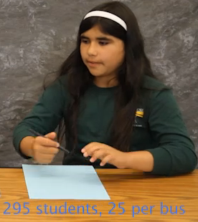
Marissa
295 students, 25 on each bus
Source: The Marilyn Burns Math Reasoning Inventory

Slide 21
Procedural Fluency
Efficiency—can carry out easily, keep track of subproblems, and make use of intermediate results to solve the problem.
Accuracy—reliably produces the correct answer.
Flexibility—knows more than one approach, chooses appropriate strategy, and can use one method to solve and another method to double-check.
Appropriately—knows when to apply a particular procedure.

Slide 22
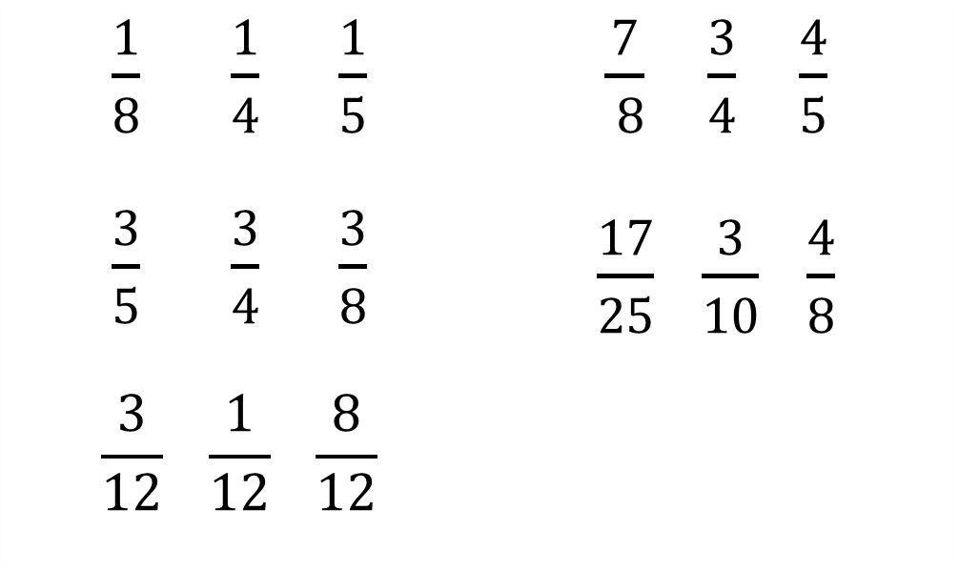
Procedural Fluency Beyond Whole Number Computation
Order each set of fractions from least to greatest.
What strategies did you use?
$\frac{1}{8} \frac{1}{4}$ $\frac{1}{5}$ $\frac{3}{5} \frac{3}{4}$ $\frac{3}{8}$ | $\frac{7}{ 8}$ $\frac{3}{4}$ $\frac{4}{5}$ $\frac{17}{25}$ $\frac{3}{10}$ $\frac{4}{8}$
$$\frac{3}{12} \frac{1}{12} \frac{8}{12}$$
1.
4.
2.
5.
3.
Notes:
Make sure to refer to the first group of fractions as Unit Fractions.

Slide 23
Comparing & Ordering Fractions
Common denominators
Common numerators
Benchmark fractions, e.g. 1, ½
Other equivalent representations, e.g., decimals, percents

Slide 24
Procedural Fluency Beyond Whole Number Computation
Solve for x.
3x + 15 = 45
3x = 30
x = 10
x + 5 = 15
x = 10
3(x + 5) = 45
Notes:
Make sure to refer to the first group of fractions as Unit Fractions.

Slide 25
Procedural Fluency
Efficiency—can carry out easily, keep track of subproblems, and make use of intermediate results to solve the problem.
Accuracy—reliably produces the correct answer.
Flexibility—knows more than one approach, chooses appropriate strategy, and can use one method to solve and another method to double-check.
Appropriately—knows when to apply a particular procedure.

Slide 26
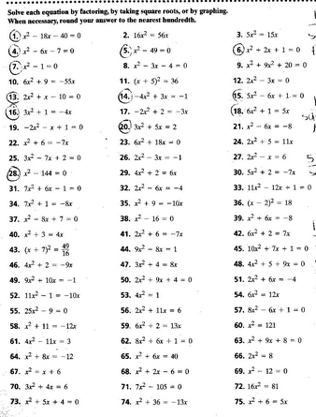
How Can We Develop Students’ Proficiency?
X

Slide 27
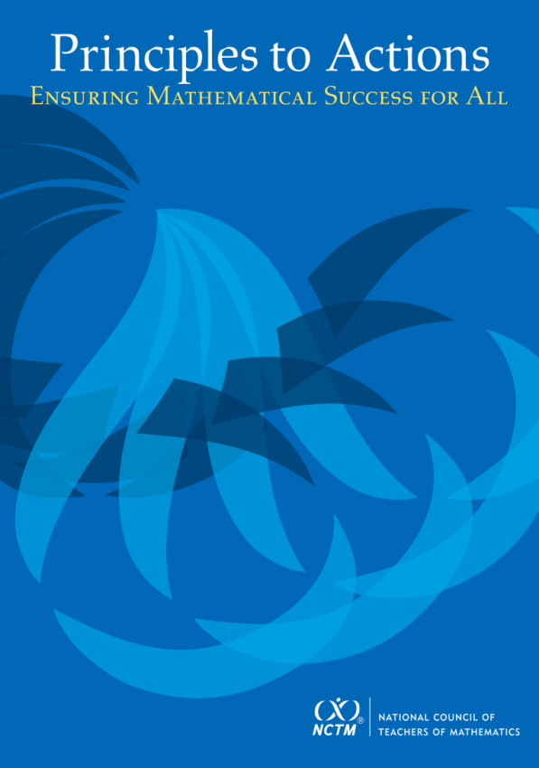
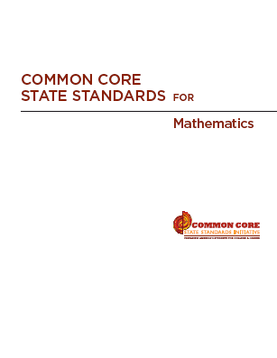
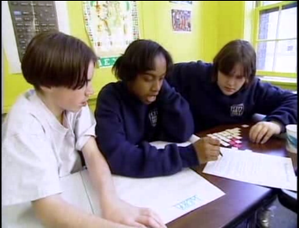
High Quality Standards Are Necessary, but Insufficient, for Effective Teaching and Learning

Slide 28

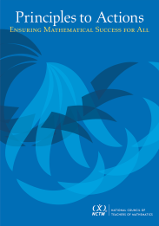
Principles to Actions:
Ensuring Mathematics Success for All
Guiding Principles for School Mathematics
Teaching and Learning
Access and Equity
Curriculum
Tools and Technology
Assessment
Professionalism
Essential Elements
of Effective Math
Programs

Slide 29
Teaching and Learning Principle
An excellent mathematics program requires effective teaching that engages students in meaningful learning through individual and collaborative experiences that promote their ability to make sense of mathematical ideas and reason mathematically.

Slide 30
Effective
Mathematics Teaching Practices
Establish mathematics goals to focus learning.
Implement tasks that promote reasoning and problem solving.
Use and connect mathematical representations.
Facilitate meaningful mathematical discourse.
Pose purposeful questions.
Build procedural fluency from conceptual understanding.
Support productive struggle in learning mathematics.
Elicit and use evidence of student thinking.

Slide 31
Effective
Mathematics Teaching Practices
Establish mathematics goals to focus learning.
Implement tasks that promote reasoning and problem solving.
Use and connect mathematical representations.
Facilitate meaningful mathematical discourse.
Pose purposeful questions.
Build procedural fluency from conceptual understanding.
Support productive struggle in learning mathematics.
Elicit and use evidence of student thinking.

Slide 32
What Research Tells Us
When procedures are connected with the underlying concepts, students have better retention of the procedures and are more able to apply them in new situations
Informal methods → general methods → formal algorithms is more effective than rote instruction.
Engaging students in solving challenging problems is essential to build conceptual understanding.

Slide 33
Candy Jar Problem
A candy jar contains 5 Jolly Ranchers (squares) and 13 Jawbreakers (circles). Suppose you had a new candy jar with the same ratio of Jolly Ranchers to Jawbreakers, but it contained 100 Jolly Ranchers. How many Jawbreakers would you have? Explain how you know.
Please work this problem as if you were a seventh grader.
When done, share your work with a neighbor.
What mathematical content does this task support?

Slide 34
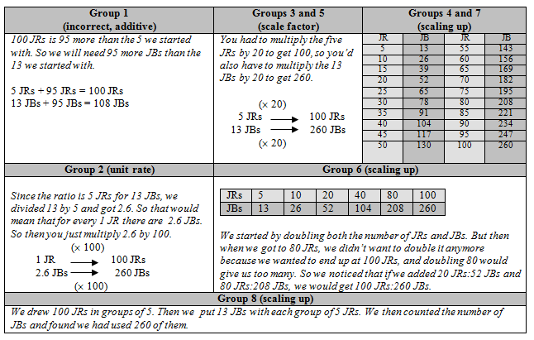
Candy Jar Problem

Slide 35

Procedural Fluency
Extending learning from the original Candy Jar Task:

Slide 36
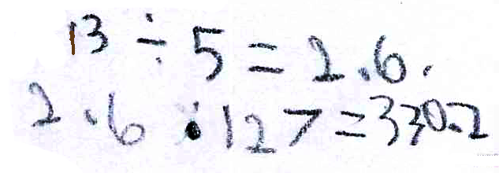
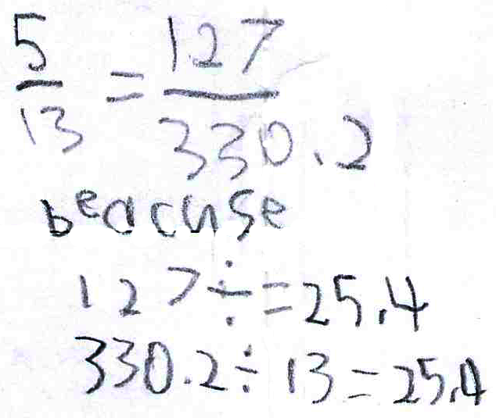
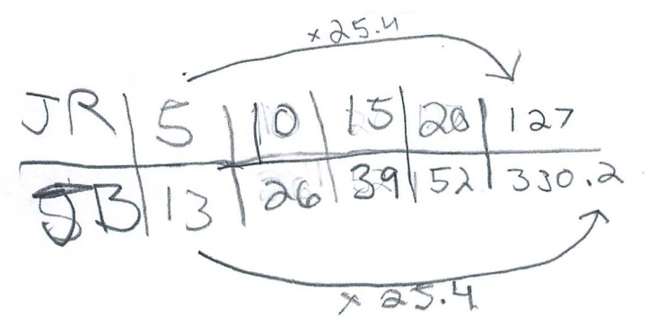
Procedural Fluency

Slide 37
Procedural Fluency
Unit Rate
Scale Factor
Scaling Up

Slide 38






Building Procedural Fluency
Finding the Missing Value
Find the value of the unknown in each of the proportions shown below.
What might we expect students to be able to do when presented with a missing value problem, after they have had the opportunity to develop a set of strategies through solving a variety of contextual problems like the Candy Jar Task?
Notes:
2 minutes to turn and talk
Same
Content
Both could be solved using cross multiplication
Different
Multiple ways to enter Candy Jar – picture, build model, make table
Multiple ways to solve CJ – scale factor, scaling up, unit rate
No implied way of solving CJ
Where the task could be used – beginning of a unit vs practicing a procedure
CJ has the potential to promote problem solving. The context also helps students in making sense of what the numbers they come up with actually mean.

Slide 39
Developing Procedural Fluency
Develop conceptual understanding building on students’ informal knowledge
Develop informal strategies to solve problems
Refine informal strategies to develop fluency with standard methods and procedures (algorithms)

Slide 40
Effective
Mathematics Teaching Practices
Establish mathematics goals to focus learning.
Implement tasks that promote reasoning and problem solving.
Use and connect mathematical representations.
Facilitate meaningful mathematical discourse.
Pose purposeful questions.
Build procedural fluency from conceptual understanding.
Support productive struggle in learning mathematics.
Elicit and use evidence of student thinking.

Slide 41
Effective
Mathematics Teaching Practices
Establish mathematics goals to focus learning.
Implement tasks that promote reasoning and problem solving.
Use and connect mathematical representations.
Facilitate meaningful mathematical discourse.
Pose purposeful questions.
Build procedural fluency from conceptual understanding.
Support productive struggle in learning mathematics.
Elicit and use evidence of student thinking.

Slide 42
Implement Tasks that Promote
Reasoning and Problem Solving
Mathematical tasks should:
Provide opportunities for students to engage in exploration or encourage students to use procedures in ways that are connected to concepts and understanding;
Build on students’ current understanding; and
Have multiple entry points.

Slide 43
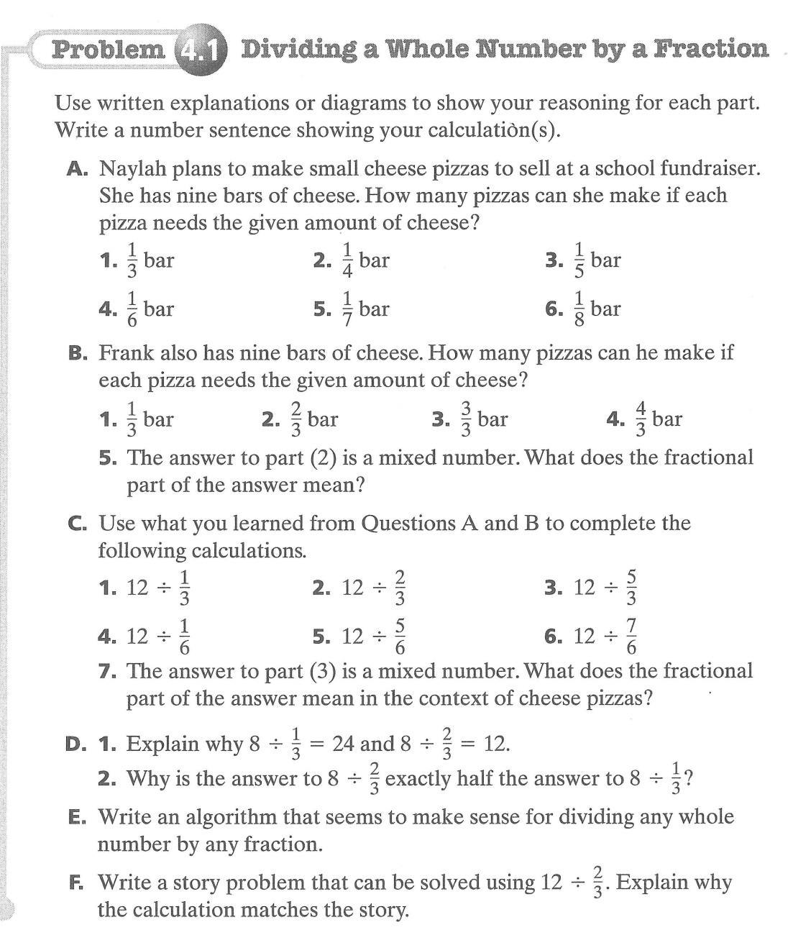
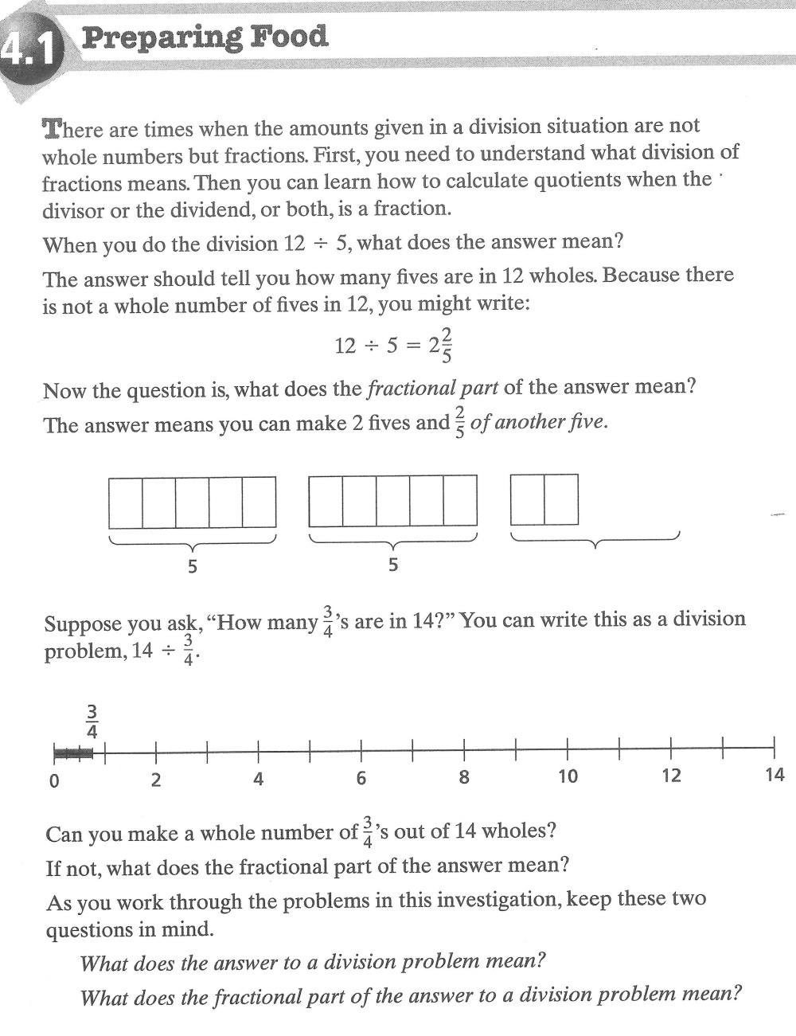
Dividing Fractions—Book 1

Slide 44
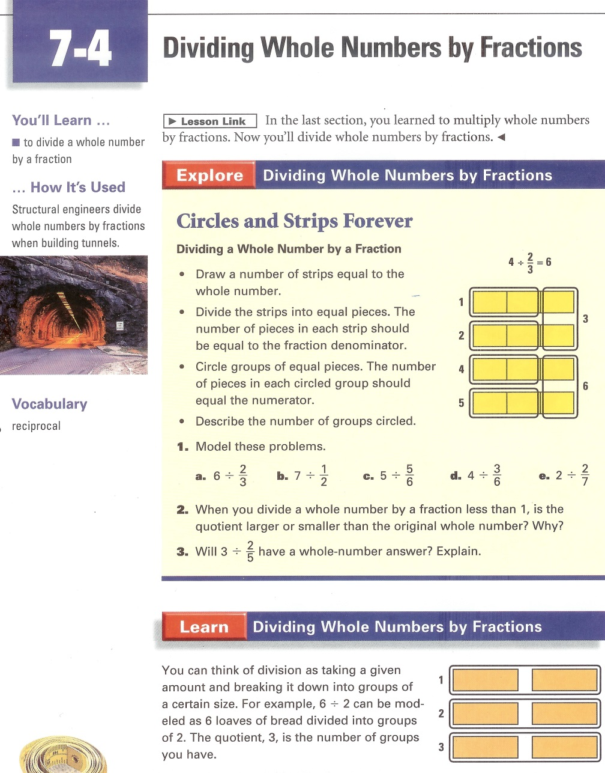
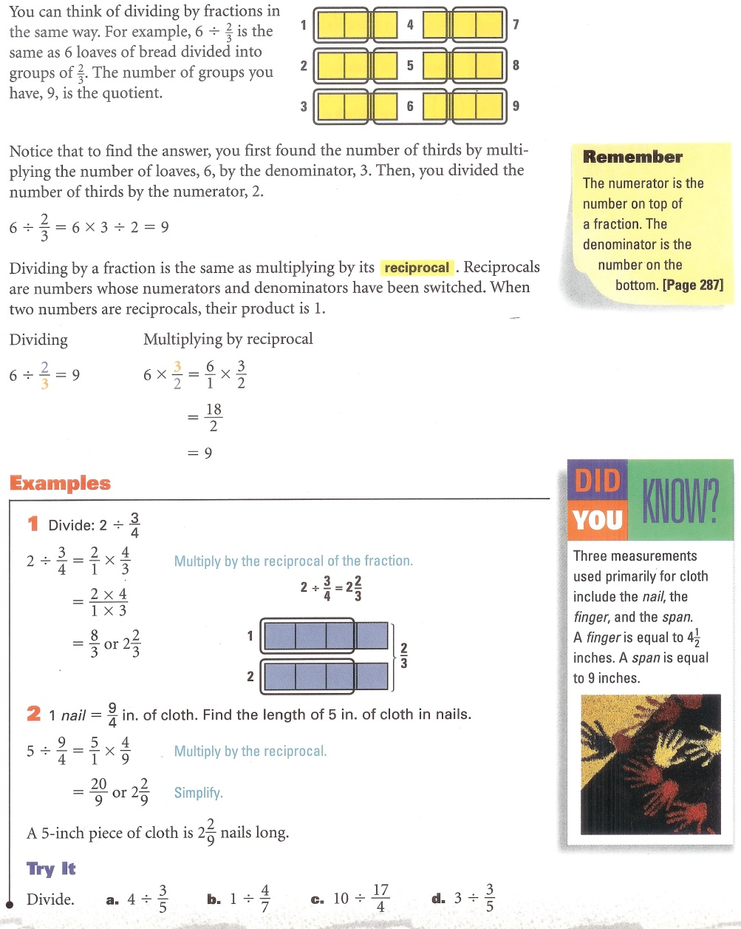
Dividing Fractions—Book 2

Slide 45

Dividing Fractions—Book 1

Slide 46
Dividing Fractions—Book 2

Slide 47
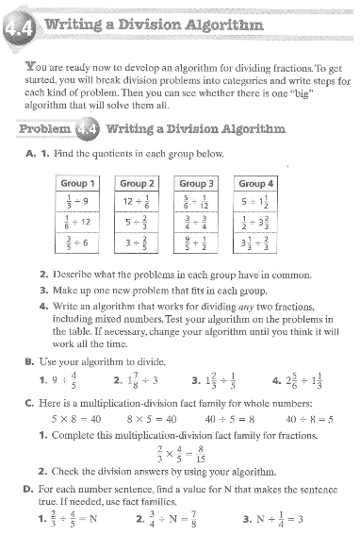
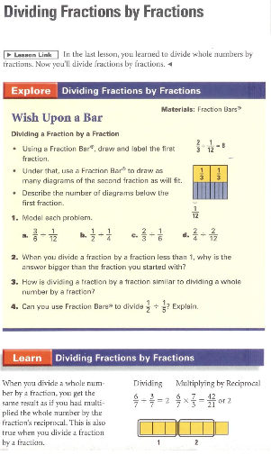
Dividing Fractions—Standard Algorithm

Slide 48
Developing Procedural Fluency
Whole Number Multiplication
Develop conceptual understanding building on students’ informal knowledge
Develop informal strategies to solve problems
Refine informal strategies to develop fluency with standard methods and procedures (algorithms)

Slide 49
 | Numbers and Operations in Base Ten
1 | Use place value understanding and properties of operations to add and subtract.
2 | Use place value understanding and properties of operations to add and subtract.
3 | Use place value understanding and properties of operations to perform multi-digit arithmetic. A range of algorithms may be used.
4 | Use place value understanding and properties of operations to perform multi-digit arithmetic. Fluently add and subtract multi-digit whole numbers using the standard algorithm.
5 | Perform operations with multi-digit whole numbers and with decimals to hundredths. Fluently multiply multi-digit whole numbers using the standard algorithm.
6 | Compute fluently with multi-digit numbers and find common factors and multiples. Fluently add, subtract, multiply, and divide multi-digit decimals using the standard algorithm for each operation.

Slide 50
 | Numbers and Operations in Base Ten
1 | Use place value understanding and properties of operations to add and subtract.
2 | Use place value understanding and properties of operations to add and subtract.
3 | Use place value understanding and properties of operations to perform multi-digit arithmetic. A range of algorithms may be used.
4 | Use place value understanding and properties of operations to perform multi-digit arithmetic. Fluently add and subtract multi-digit whole numbers using the standard algorithm.
5 | Perform operations with multi-digit whole numbers and with decimals to hundredths. Fluently multiply multi-digit whole numbers using the standard algorithm.
6 | Compute fluently with multi-digit numbers and find common factors and multiples. Fluently add, subtract, multiply, and divide multi-digit decimals using the standard algorithm for each operation.

Slide 51
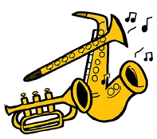
The Band Concert
Make a quick sketch or diagram of the situation.
How might
Grade 3 students approach this task?
The third-grade class is responsible for
setting up the chairs for their spring band
concert. In preparation, they need to
determine the total number of chairs that
will be needed and ask the school’s
engineer to retrieve that many chairs from the
central storage area.
The class needs to set up 7 rows of chairs with
20 chairs in each row, leaving space for a center aisle.
How many chairs does the school’s engineer need
to retrieve from the central storage area?
Notes:
Allow about 1 minute.

Slide 52
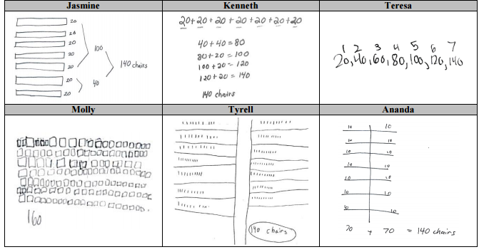
The Band Concert

Slide 53
Starting Point to Build Procedural Fluency
The Band Concert
The third-grade class is responsible for setting up the chairs for their spring band concert. In preparation, they need to determine the total number of chairs that will be needed and ask the school’s engineer to retrieve that many chairs from the
central storage area.
The class needs to set up 7 rows of chairs with 20 chairs in each row, leaving space for a center aisle.
How many chairs does the school’s engineer need to retrieve from the central storage area?
Find the product
5 x 20 =
6 x 80 =
4 x 70 =
3 x 50 =
9 x 20 =
2 x 60 =
8 x 30 =
Notes:
6076 (1.037)^{t}
21,671
Algebra 2
Holt, Rinehart and Winston, 2004
Page 415

Slide 54
The Band Concert

Slide 55
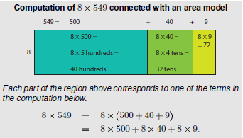
Multiplication Algorithms

Slide 56
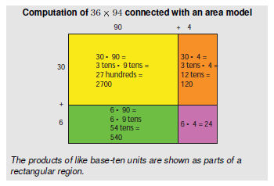
Multiplication Algorithms
CCSS Numbers and Operations in Base-Ten Progression, April 2011

Slide 57
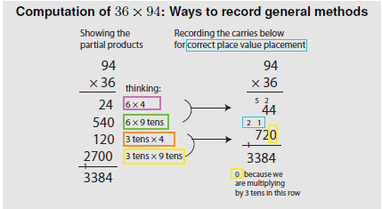
Multiplication Algorithms
CCSS Numbers and Operations in Base-Ten Progression, April 2012

Slide 58
What is Meant by
“Standard Algorithm?”
“In mathematics, an algorithm is defined by its steps and not by the way those steps are recorded in writing. With this in mind, minor variations in methods of recording standard algorithms are acceptable.”
Fuson & Beckmann, 2013; NCSM Journal, p. 14

Slide 59
What is Meant by
“Standard Algorithm?”
“In mathematics, an algorithm is defined by its steps and not by the way those steps are recorded in writing. With this in mind, minor variations in methods of recording standard algorithms are acceptable.”
Fuson & Beckmann, 2013; NCSM Journal, p. 14

Slide 60


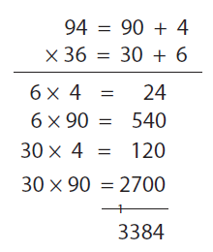
Multiplication Algorithms
Fuson & Beckmann, 2013, p. 25

Slide 61
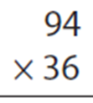
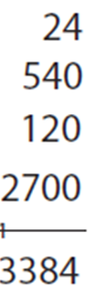
Multiplication Algorithms
Fuson & Beckmann, 2013, p. 25

Slide 62
Providing a Basis for Future Learning
36 x 94
(x + 6)(x + 4)
90 + 4
x + 4
2700 | 120
540 | 24
x² | 4x
6x | 24
30
+
6
2820
x
+
6
x²+4x
564
6x+24
3384
x²+10x+24

Slide 63
Procedural Fluency
Efficiency—can carry out easily, keep track of subproblems, and make use of intermediate results to solve the problem.
Accuracy—reliably produces the correct answer.
Flexibility—knows more than one approach, chooses appropriate strategy, and can use one method to solve and another method to double-check.
Appropriately—knows when to apply a particular procedure.

Slide 64
Developing Procedural Fluency
Develop conceptual understanding building on students’ informal knowledge
Develop informal strategies to solve problems
Refine informal strategies to develop fluency with standard methods and procedures (algorithms)

Slide 65
Build Procedural Fluency from Conceptual Understanding
What are teachers doing? | What are students doing?
Providing students with opportunities to use their own reasoning strategies and methods for solving problems. Asking students to discuss and explain why the procedures that they are using work to solve particular problems. Connecting student-generated strategies and methods to more efficient procedures as appropriate. Using visual models to support students’ understanding of general methods. Providing students with opportunities for distributed practice of procedures. | Making sure that they understand and can explain the mathematical basis for the procedures that they are using. Demonstrating flexible use of strategies and methods while reflecting on which procedures seem to work best for specific types of problems. Determining whether specific approaches generalize to a broad class of problems. Striving to use procedures appropriately and efficiently.

Slide 66
Effective
Mathematics Teaching Practices
Establish mathematics goals to focus learning.
Implement tasks that promote reasoning and problem solving.
Use and connect mathematical representations.
Facilitate meaningful mathematical discourse.
Pose purposeful questions.
Build procedural fluency from conceptual understanding.
Support productive struggle in learning mathematics.
Elicit and use evidence of student thinking.

Slide 67
The Title Is Principles to Actions
Your Actions?

Slide 68
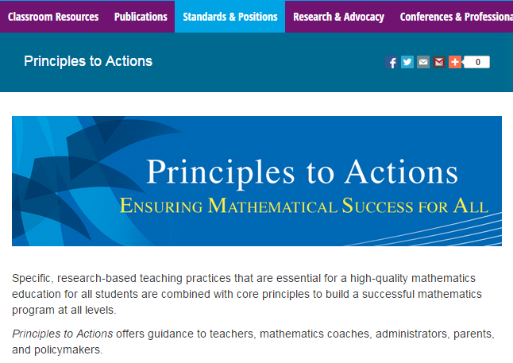
http://www.nctm.org/PtA/

Slide 69
Principles to Actions Resources
Principles to Actions Executive Summary
(in English and Spanish)
Principles to Actions overview presentation
Principles to Actions professional development guide (Reflection Guide)
Mathematics Teaching Practices presentations
  Elementary case, multiplication (Mr. Harris)
  Middle school case, proportional reasoning (Mr. Donnelly) (in English and Spanish)
  High school case, exponential functions (Ms. Culver)
Principles to Actions Spanish translation

Slide 70
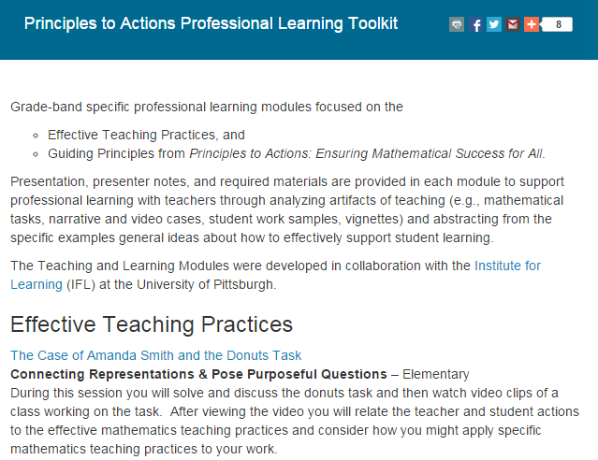
http://www.nctm.org/PtAToolkit/

Slide 71
Thank You!
Diane Briars dbriars@nctm.org

